Slide 1
CHAPTER 9
NETWORK MANAGEMENT

Slide 2
Introduction
Network Management encompasses both human and automated tasks that support the creation, operation and evolution of a network
For a network to be effective and efficient over a long period of time, a network management plan must have two goals:
  Prevent problems where possible
  Prepare for problems that will mostly likely occur

Slide 3
Responsibilities of a
Network Manager
Policy Management
Evaluation of Hardware and Software
Network Administration & Maintenance
Network Security
Configuration Management

Slide 4
Policy Management
Policy management is an implementation of a set of rules or policies to dictate user connectivity and network resource priorities. It includes three fundamental functions:
  Configuring network switches and routers
  Verifying (or auditing) network operation
  Enforcing the policies, especially technology standards

Slide 5
Evaluation of Network Hardware
Client/Server Environment Critical Issues
  Server response time
    Dedicated server
    Remote access server
  Server’s ancillary storage: RAID
    RAID 0 (Striping)
    RAID 1 (Mirroring)
    RAID 3, 4, or 5 (Parity-checking RAID)
  Server downtime (for upgrades or maintenance)
  Server utilization rate
Network administrators are often called on to advise users about ergonomic design of a workstation

Slide 6
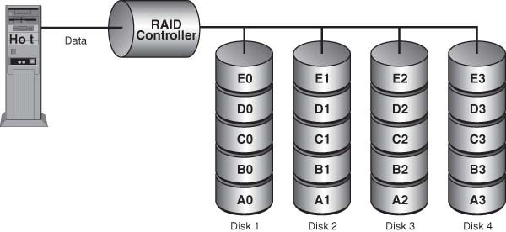
RAID 0 (also called Striping)

Slide 7
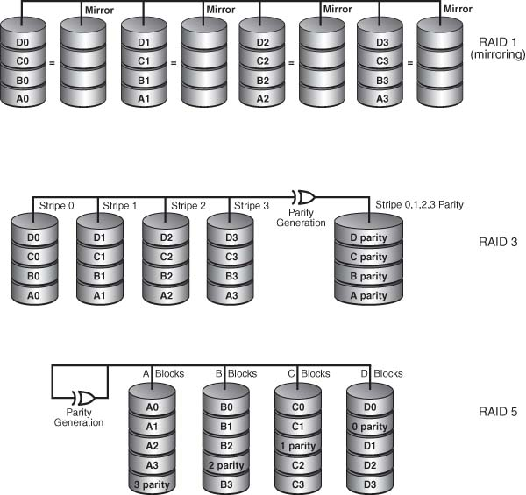
RAID Levels: 1 (Mirroring), and
3, and 5 (Parity-Checking)

Slide 8
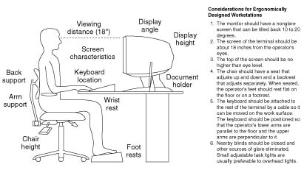
Ergonomically-designed Workstation
Courtesy of Telecommunications for Managers 4/E by Rowe, S.H., copyright 1995. Reprinted with permission of Prentice-Hall, Inc., Upper Saddle River, N.J.

Slide 9
Network Software
Network software must be chosen based on needs ― present and future ― and a careful comparison of the capabilities of the existing product, as well as on the vendor’s capabilities to deliver future upgrades
  Platform
    Underlying system on which applications run
    Consists of an operating system and a microprocessor
    Example: Windows XP, Mac OS X, Linux
  Network Operating System (NOS)
    Provides centralized administration of the entire network

Slide 10
Evaluation Characteristics of NOS
Architecture
Functionality, Reliability, Scalability
Broad Network Media and Client Support
Network Services and Applications
Support for Different Network Protocols
Server Management
Application Development Tools

Slide 11
Network Administration and Maintenance
Network administration and maintenance
  An infrastructure of techniques and procedures that assure the proper day-to-day operation of the network
  Detect failures and degraded performance
  Take corrective action before services are effected
  Manage network changes to minimize disruption
  Keep abreast of emerging technologies

Slide 12
Network Operations Center (NOC)
NOC is usually a separate room from which a telecommunications network is managed, monitored, and maintained to endure uninterrupted service for its users
NOC is the focal point for troubleshooting, software distribution and update, and performance monitoring

Slide 13
Day-to-Day Maintenance Tasks of a Network Administrator
Provide timely communications
Monitor and control disk space
Add to and maintain user login information and workstation information
Setup e-mail and Internet access accounts
Manage resource and file access
Monitor and reset network devices
Update security software
Install software upgrades for servers and workstations
Maintain records of user accounting and billing

Slide 14
Implementing Virtual LANs
VLAN is a switched network that is logically segmented by functions, project teams, or applications, rather than on a physical or geographical basis
Network is reconfigured through software rather than by physically moving devices
VLAN software is mostly proprietary
VLAN implements the corollary: switch when you can, route when you must

Slide 15
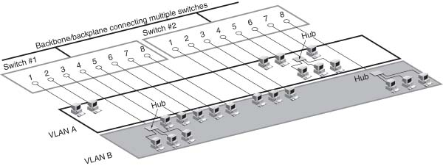
VLAN

Slide 16
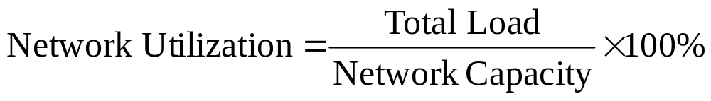
Network Utilization
Network Utilization is defined as the ratio of total load to network capacity
Since utilization cannot exceed 100%, transmitted frames beyond network capacity are lost and must be repeated

Slide 17
Network Security
Computer and Network Security can be defined as the protection of network-connected resources against unauthorized disclosure, modification, utilization, restriction, incapacitation, or destruction
Computer security
  Tools to support stored data
Network security
  Tools to support data during its transmission

Slide 18
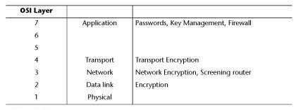
Network Security Measures at Different Layers of the OSI Model

Slide 19
Types of Security Threats
Security threats divided into two categories:
  Passive threats
    Involve monitoring the transmission data of an organization. These threats are difficult to detect because they do not involve alteration of the data
  Active threats
    Involve some modification of the data stream or the creation of a false stream. These threats are most successful when directed at the weakest link in the overall system, namely, at the host level

Slide 20
Viruses and Worms
Virus
  A program that affects other programs by modifying them; the modified program includes a copy of the virus program, which can then go on to infect other programs
Worm
  A program that makes use of networking software to replicate itself and move from system to system; it performs some detrimental activity on the system it gains access to

Slide 21
Vulnerability Assessment
Vulnerability assessment
  Identifies points of exposures in the network
Internal assessment
  Internal audits
External assessment
  May require outsourcing security services to perform penetration tests

Slide 22
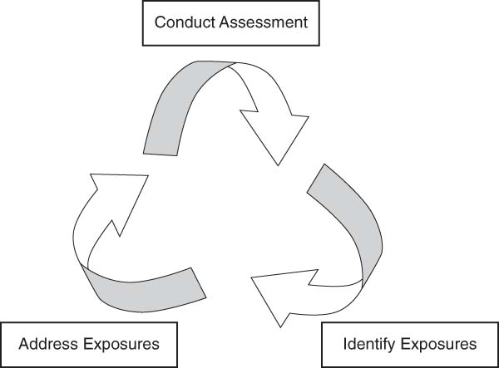
Vulnerability Management
Vulnerability Management is a cyclic process

Slide 23
Security Measures
Authorization
  user ID and password
Encryption
  Hash functions
  Private Key
  Public Key
Authentication
  Certificate Authority (CA)
Intrusion Detection Systems (IDS)
Firewall

Slide 24
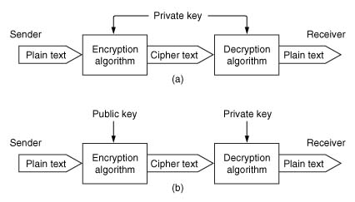
Encryption Process:
Public Key and Private Key

Slide 25
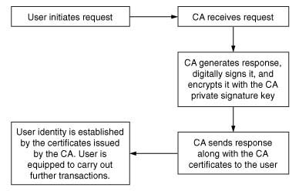
Certification Authority (CA)

Slide 26
Intrusion Detection Systems (IDS)
Monitoring/analysis tools
  Active monitoring
    Notifies administrator whenever an incident occurs
  Passive monitoring
    Keeps a log of each activity for review later
Port Mirroring
  Mirrors the switched traffic to an analyzer
  May drop packets due to buffer overflow, and filters anomalies like corrupt network packets
In-line Taps
  Sees 100% of the traffic

Slide 27
Firewall
Firewall is a piece of hardware and software that allows limited access into and out of one’s network from the Internet
Firewalls are classified into three categories:
  Packet filters
  Application-level gateways
  Proxy servers

Slide 28
Security Provisions in a VPN
Security gateways
Security policy servers
Certification Authorities (CA)

Slide 29
Network Applications and Services: Storage
  Direct Attached Storage (DAS)
    Attached directly to a server, most secure
    Supports only a homogeneous network environment
  Network Attached Storage (NAS)
    Disk storage that is set up with its own network address rather than being attached to the server
    Support heterogeneous data sharing
    Provide file access services
  Storage Area Network
    Composed of servers and storage devices that are connected by a network infrastructure
    Provides block-access
    Supports only a homogeneous network environment

Slide 30
Network Applications and Services
Network Application Software
  Three-tier versus two-tier application
Business Continuance: processes and procedures put in place to ensure that essential functions can continue during and after a disaster
  Asynchronous replication
    Enables fast recovery
    Not appropriate for critical applications
  Synchronous replication
    Also called “mirroring”
    Maintains complete data integrity
    Expensive and slow

Slide 31
Telecommunications Management Network (TMN)
TMN architecture has three parts:
  Logical
    Specifies the management functions and reference points for data exchange between the functions
  Physical
    Defines how management functions are implemented on real systems and the interfaces between them
  Information
    Defines the data structures

